Slide 1
DW Real Estate
Data Wrangling for a better home

Slide 2
Table of contents
01
02
03
04
Client & Dataset
Hypotheses
Findings & Insights
Prospects

Slide 3
Buying Client: Larry Sanders
Waterfront
Limited Budget
A house on the waterfront offers scenic views and a close-up experience of nature. Pure relaxation.
Achieving the maximum with a small budget is everyone's dream. And possible with us!
Nice & Isolated
Central
A beautiful home without annoying neighbors and noise. We do feel your need.
Preference for a central neighborhood without children. Germs are a threat: Your own children should not play with others to protect your family.

Slide 4
Dataset
Location
Overall
Key Variables
Region
King County Housing Data
21,597 Properties
22 Characteristics
Missing Information: Waterfront 11% View: 0.3%
Price
78,000 – 7,700,000 $US
Average: ~540,000 $US
USA, Washington State
Footage
Lot ft²
520 – 1,651,359 ft2
Average: ~15100 ft2
Neighbor
Lot ft²
651 – 871,200 ft2
Average: ~12758 ft2
Area
Bedrooms
1 – 33 Average: ~3.5
King County / Seattle
Others
e.g. Waterfront, View, Date sold

Slide 5
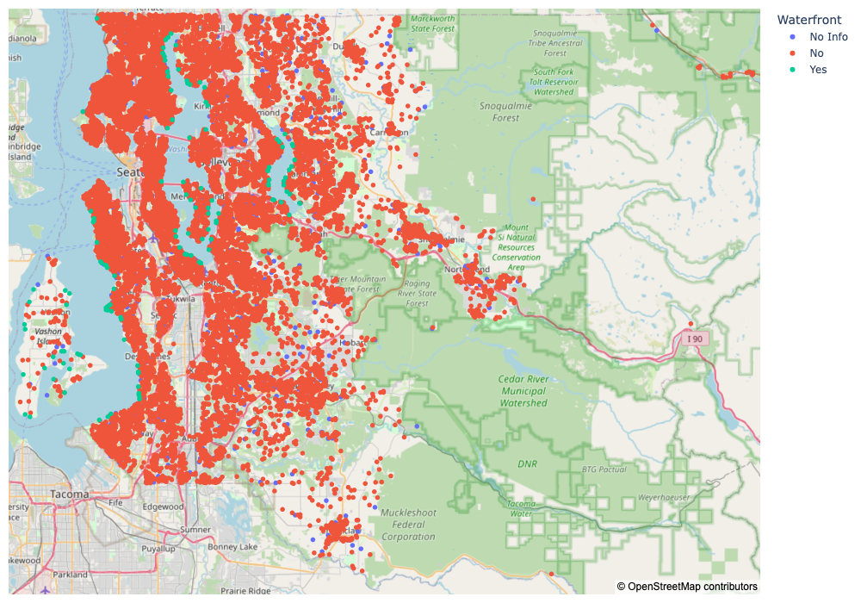
Overview Covered Area

Slide 6
Hypotheses
H1: Waterfront and price
H2: Own and neighbor lot
H3: Season and price
If the house is at the waterfront, then the price will be higher because of a greater demand.
If the footage of the lot is big, then the lots in the neighborhood will also be big.
If you buy the house in a colder season, then the price will be lower because nobody is in the mood to look at houses.

Slide 7
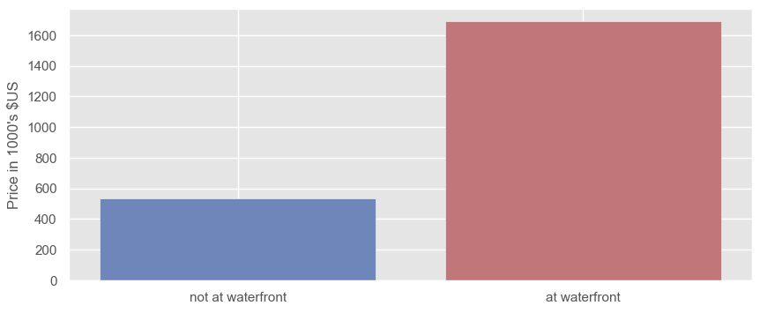
Average house price

Slide 8
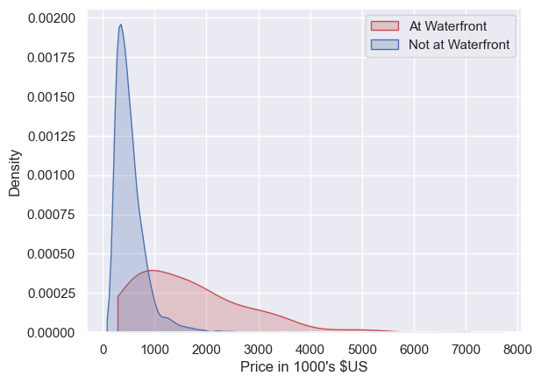
Density of houses by price

Slide 9
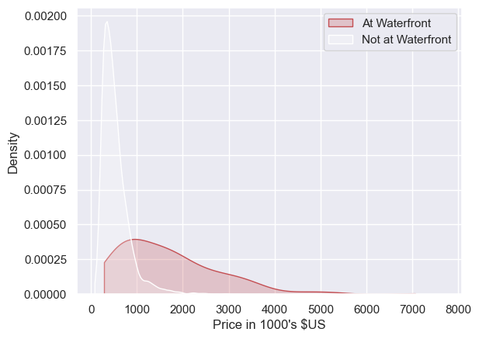
Density of houses by price
The 25% most affordable houses:
285.000 – 795.000 $US

Slide 10
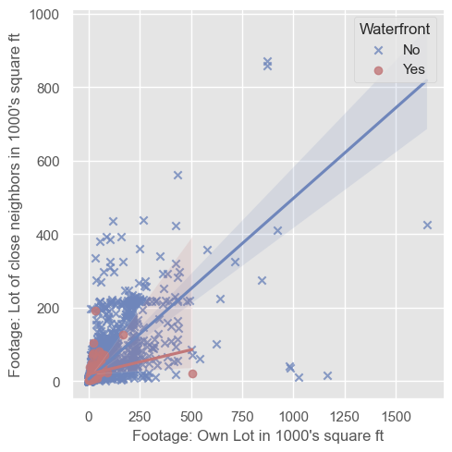
Comparison of Lot Footage

Slide 11
Waterfront: price range
count | 19060 | 155
mean | 533 | 1689
min | 78 | 285
Lowest 25% | 320 | 795
50% | 450 | 1410
75% | 639 | 2265
max | 7700 | 7060

Slide 12
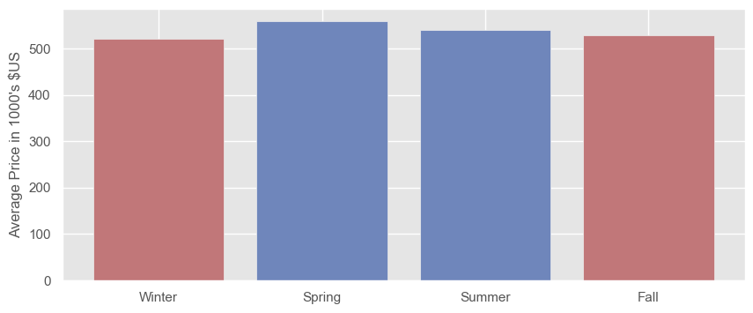
Average price by season
17% of annual sales
32% of annual sales
28% of annual sales
23% of annual sales

Slide 13
Hypotheses
H1: Waterfront and price
H2: Own and neighbor lot
H3: Season and price
If the house is at the waterfront, then the price will be higher because of a greater demand.
If the footage of the lot is big, then the lots in the neighborhood will also be big.
If you buy the house in a colder season, then the price will be lower because nobody is in the mood to look at houses.
→ true
in general but not for the waterfront
→ true
→ not clear

Slide 14
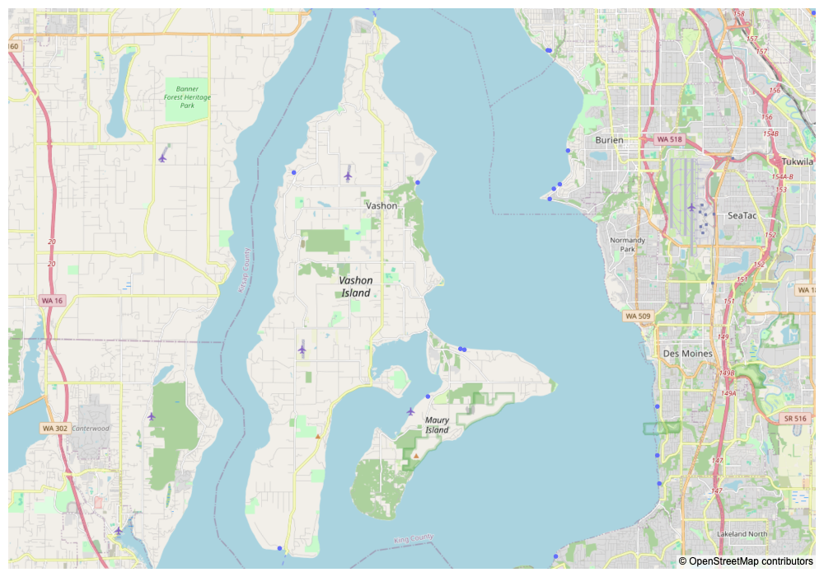
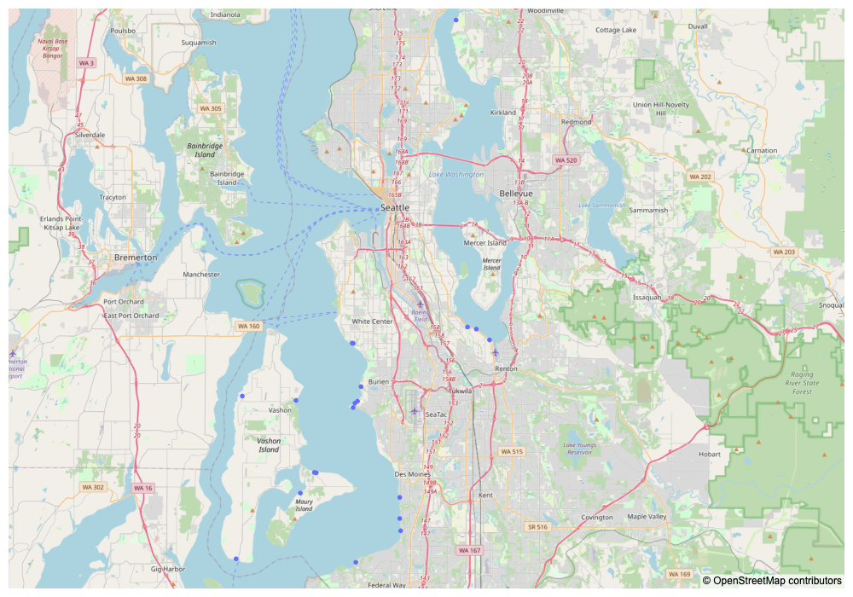
Best fit
Waterfront
Houses designated waterfront
Houses without information about waterfront, but with a high view score and could be visually identified on the map at waterfront.
Low Budget
The most affordable 25% of houses at the Waterfront.
Kids
Only accommodations with at least 3 bedrooms were selected.
Isolation
Vashon Island

Slide 15
Prospects
Price by Season:
Group comparison waterfront or not
Density:
specification of areas (e.g. grid via latitude/longitude) with the housing data set and estimate the number of existing properties (not representative)
Location/Neighborhood :
enrich data using population data
link via ZIP-code or geo reference (longitude/latitude)

Slide 16
Thanks!
Do you have any questions?
I kept this slide for attribution

